Slide 1
I am functional OO and You can Too!
Will Pleasant-Ryan

Slide 2
Functional Programming is great
Functions!
first-class citizens
partial application / currying
composition

Slide 3
Functional Programming is great
Immutability!
No side effects
deep equality
reduce surprises / hidden complexity
easier to analyze & test

Slide 4
Functional Programming is great
But Wait there’s more!
Algebraic data types – expressively constrain valid states
Monads – control data flow
Homoiconicity – code-as-data, METAPROGRAMMING

Slide 5
But sometimes Functional programming isn’t the right choice
Explicit customer requirement
Customer ecosystem
Eventual maintainers
Existing libraries / ecosystem in problem domain

Slide 6
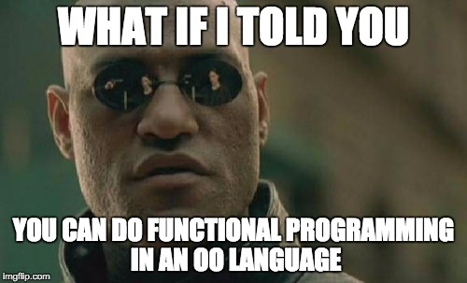

Slide 7
Functional OO
We’ll Examine techniques for writing more functional code in:
Ruby
C#
Javascript

Slide 8
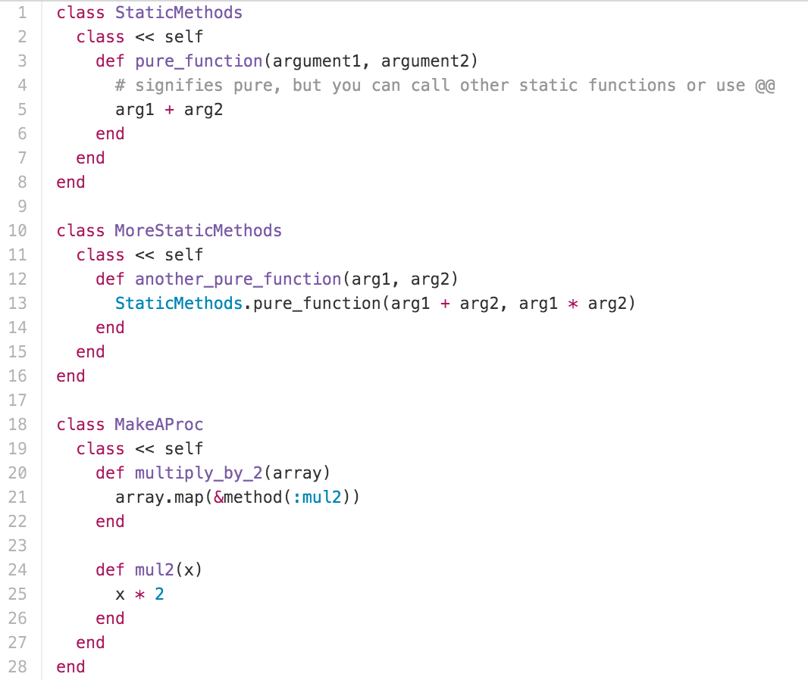
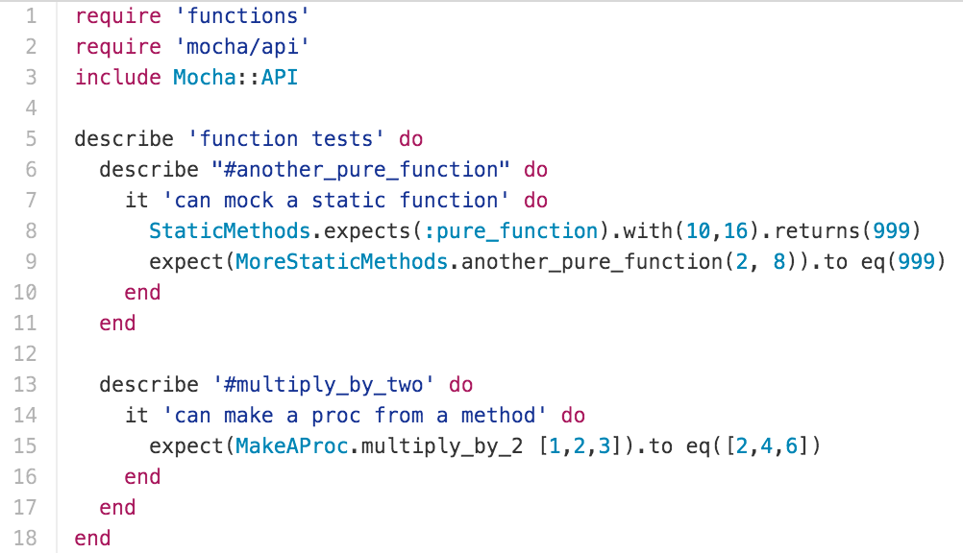
Functions As First-Class Citizens
Ruby

Slide 9
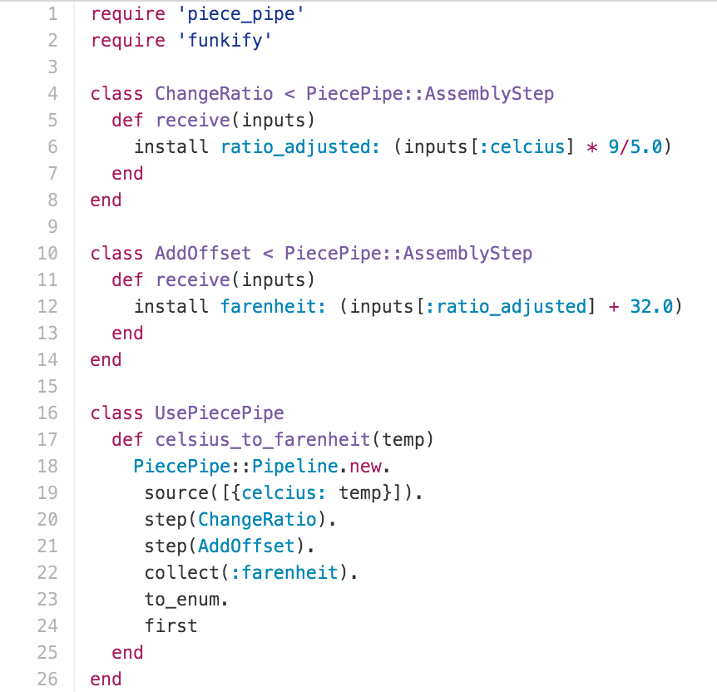
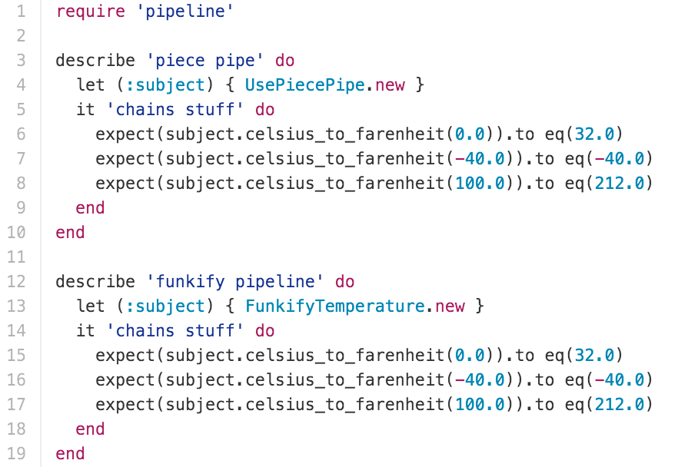
Partial Application / CURRYING / Function Composition

Slide 10
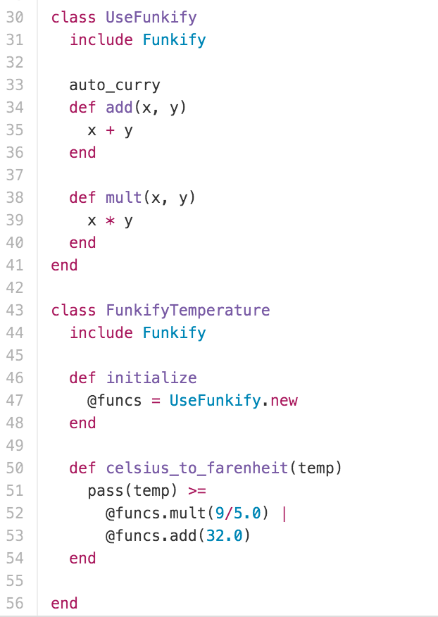
Partial Application / CURRYING / Function Composition
Notes:
Illegible to call func(func(func(x))), ugly to assign each step

Slide 11
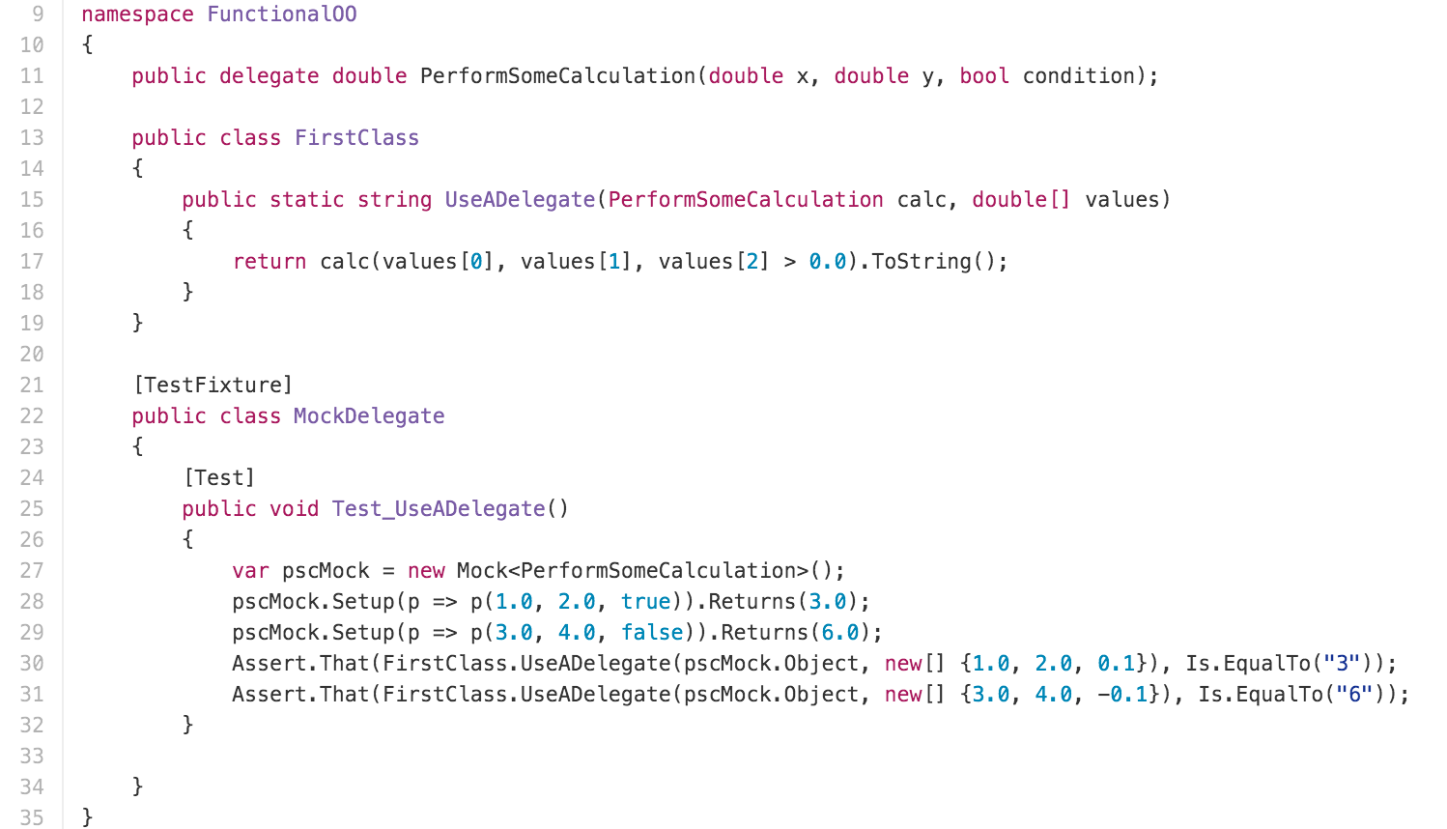
Functions As First-Class Citizens

Slide 12
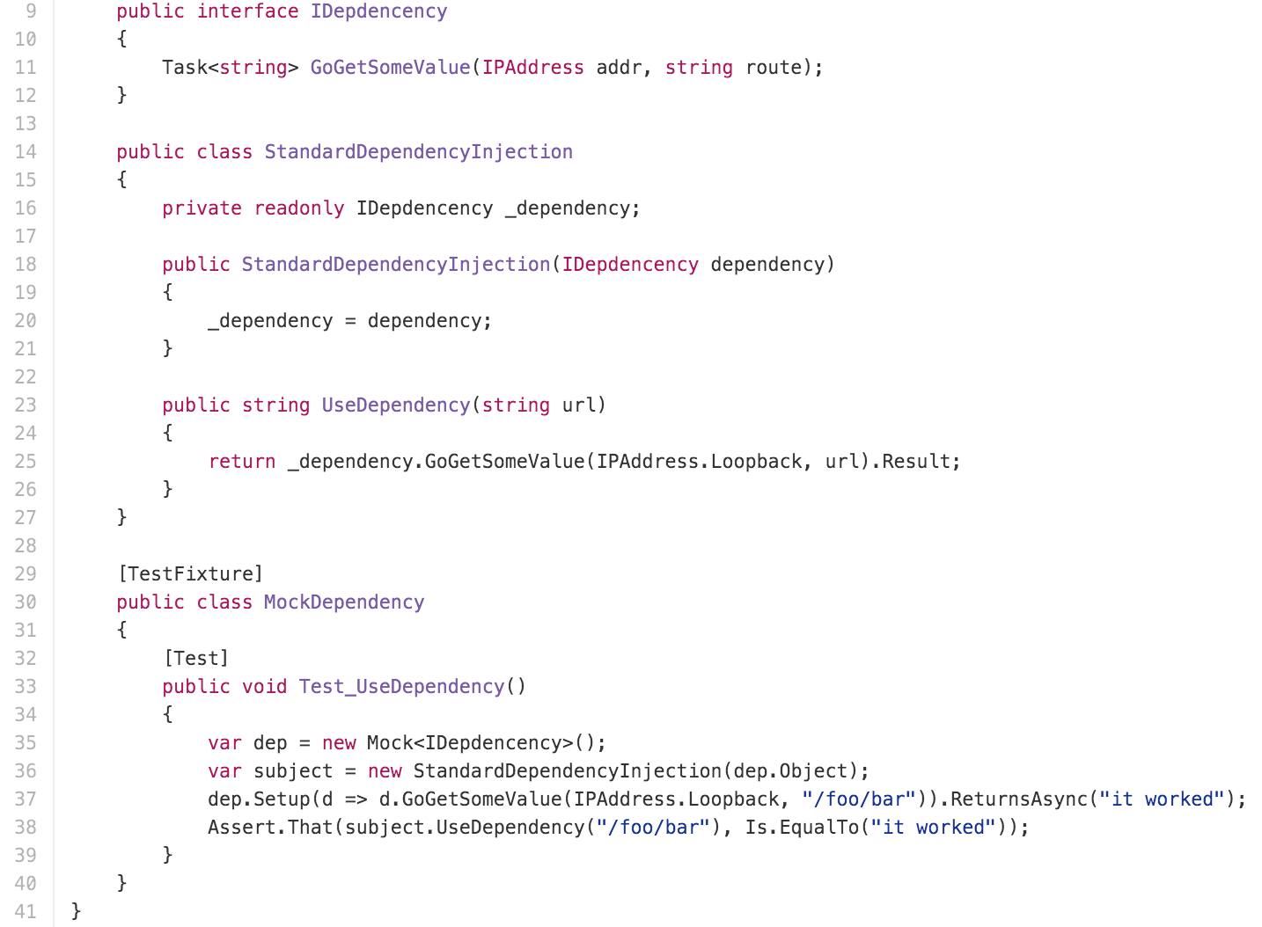
Partial Application / CURRYING

Slide 13
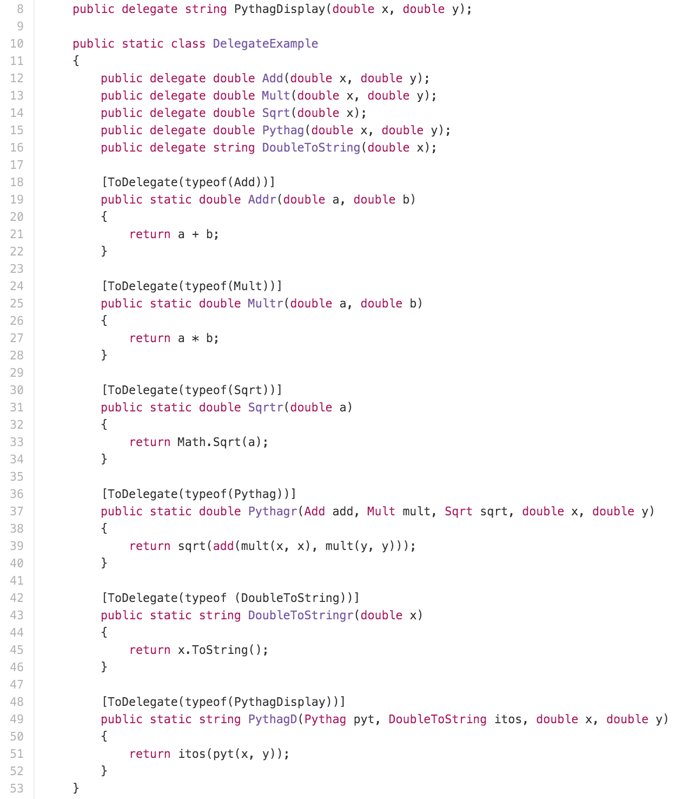
Partial Application / CURRYING

Slide 14
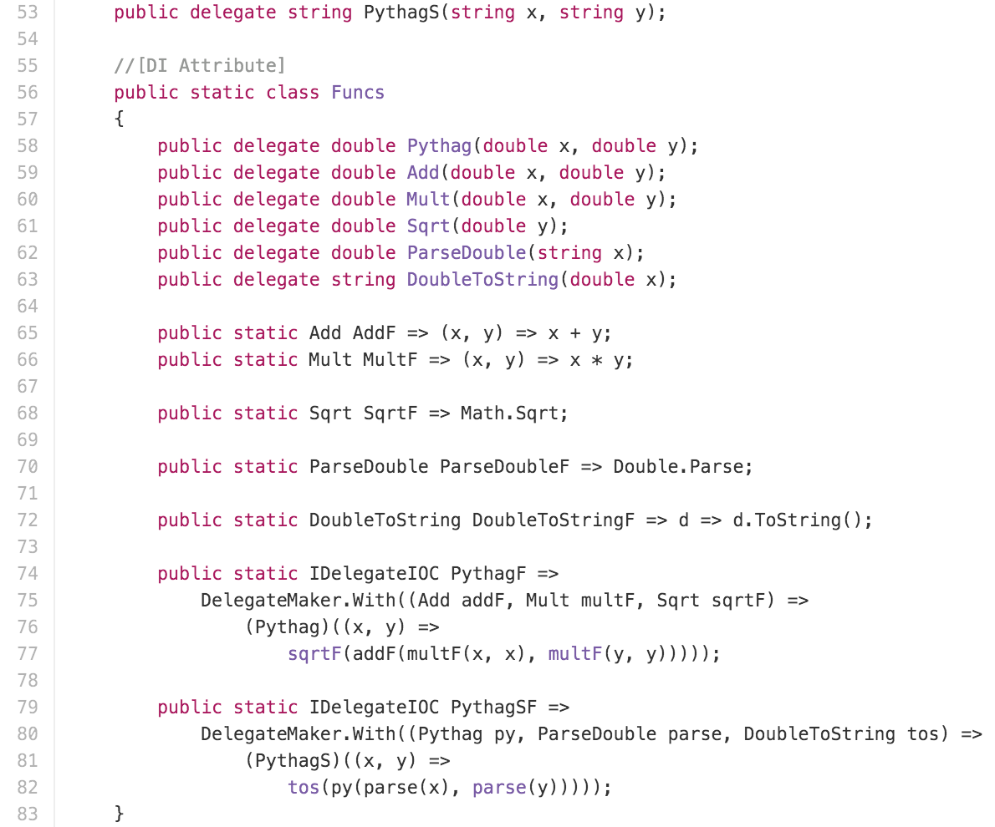
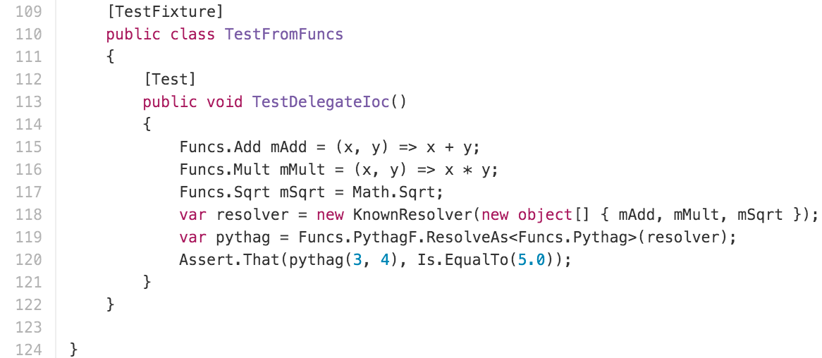
Partial Application / CURRYING

Slide 15
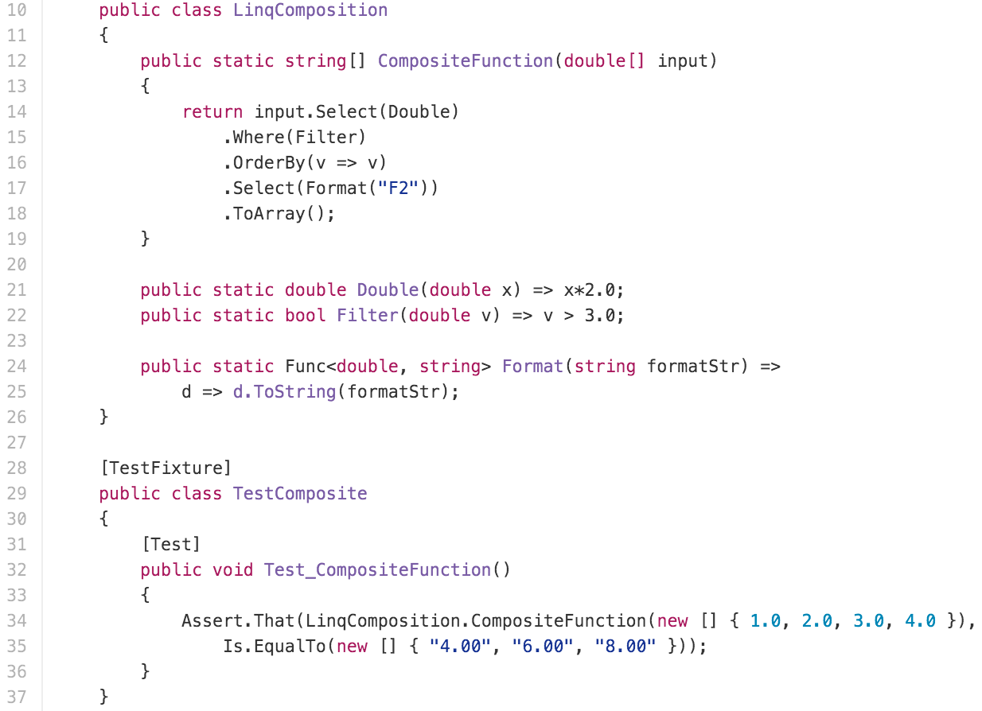
FUNCTION COMPOSITION

Slide 16
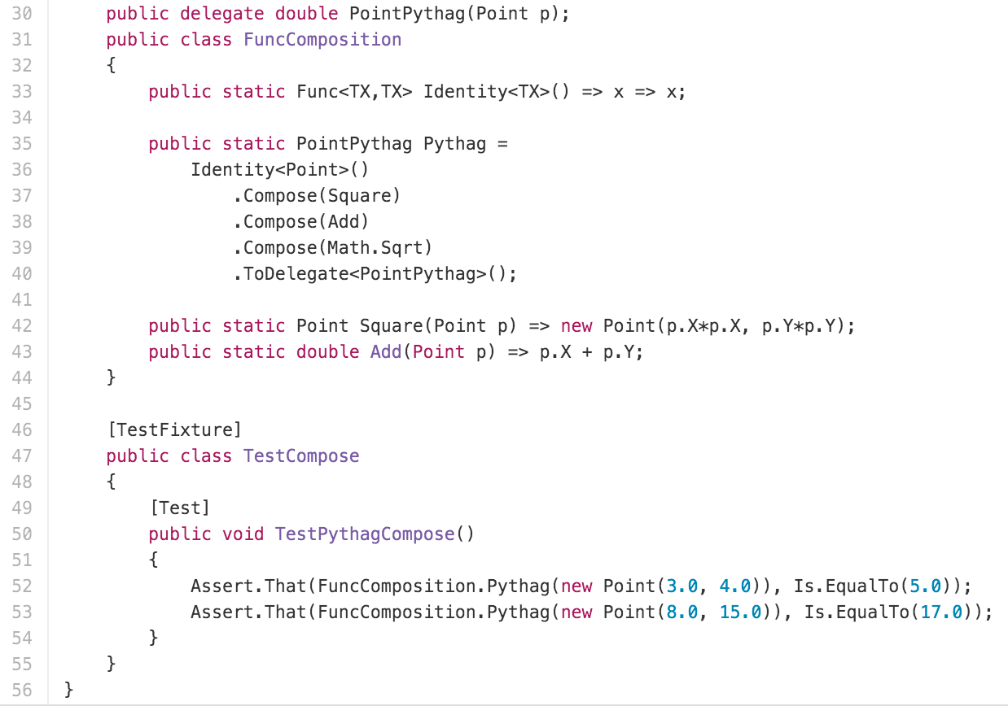
FUNCTION COMPOSITION

Slide 17
Functions As First-Class Citizens
Built in to javascript

Slide 18
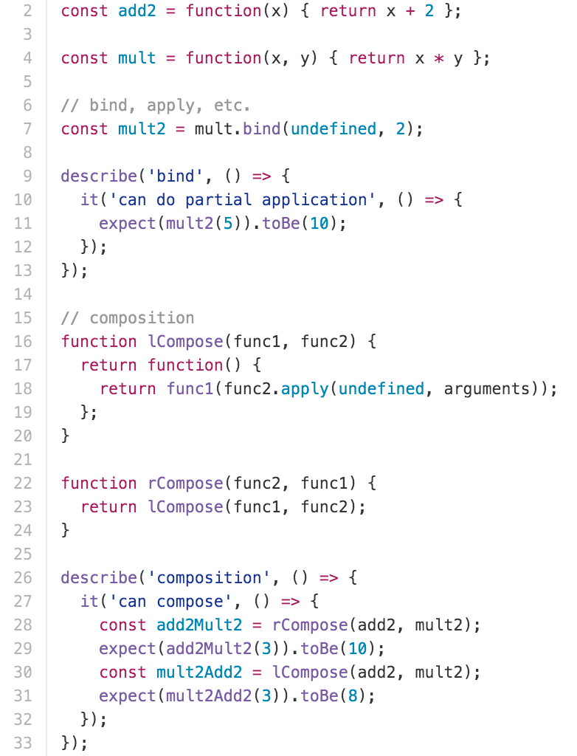
Partial Application / CURRYING / Function Composition

Slide 19
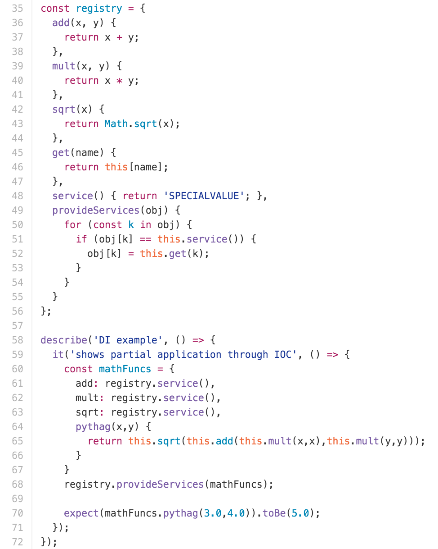
Partial application

Slide 20
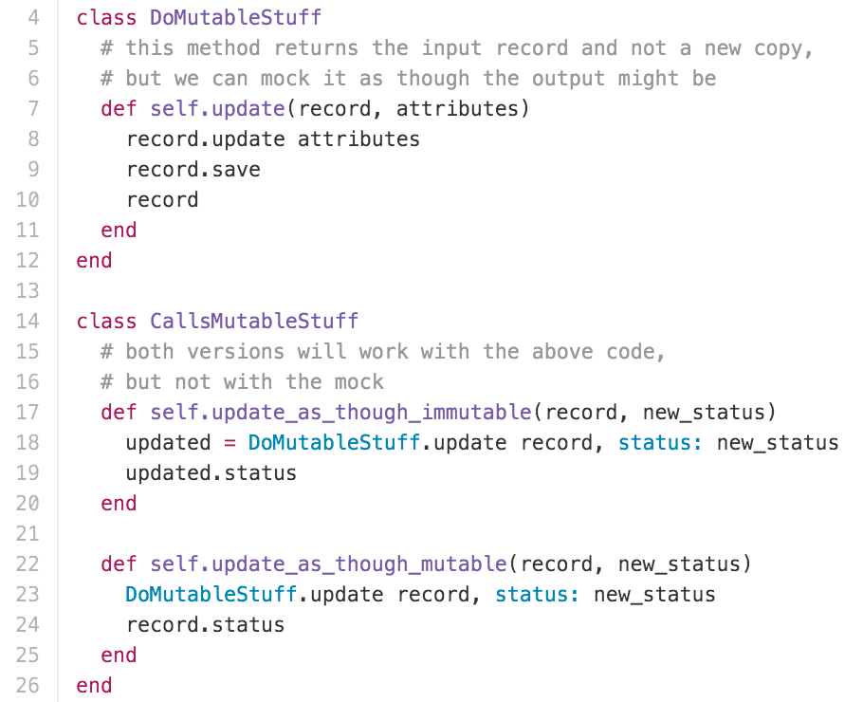
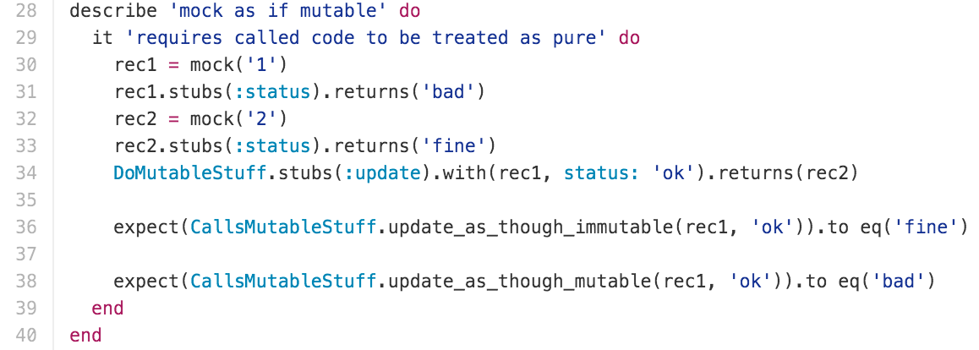
IMMUTABILITY

Slide 21
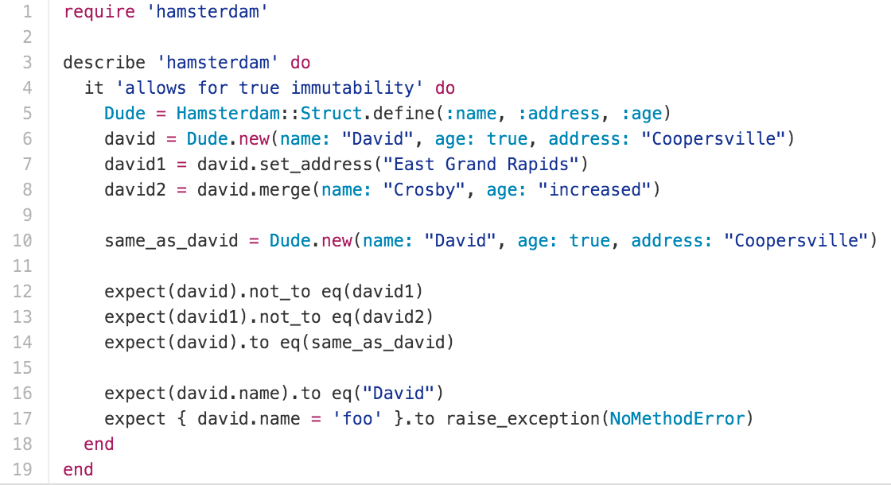
IMMUTABILITY

Slide 22
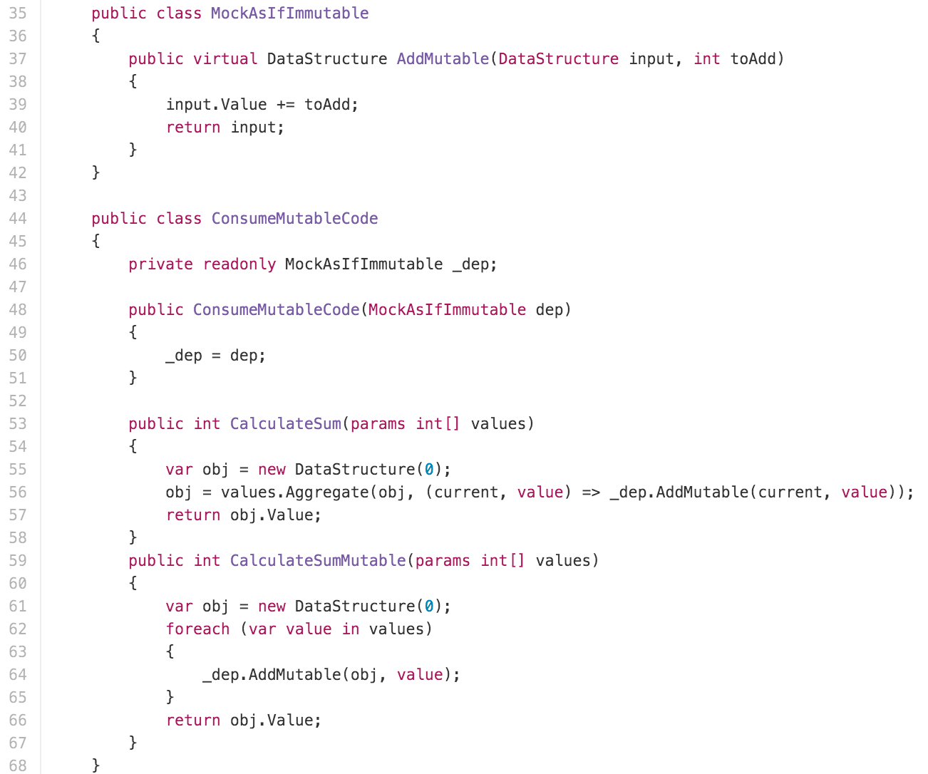
IMMUTABILITY

Slide 23
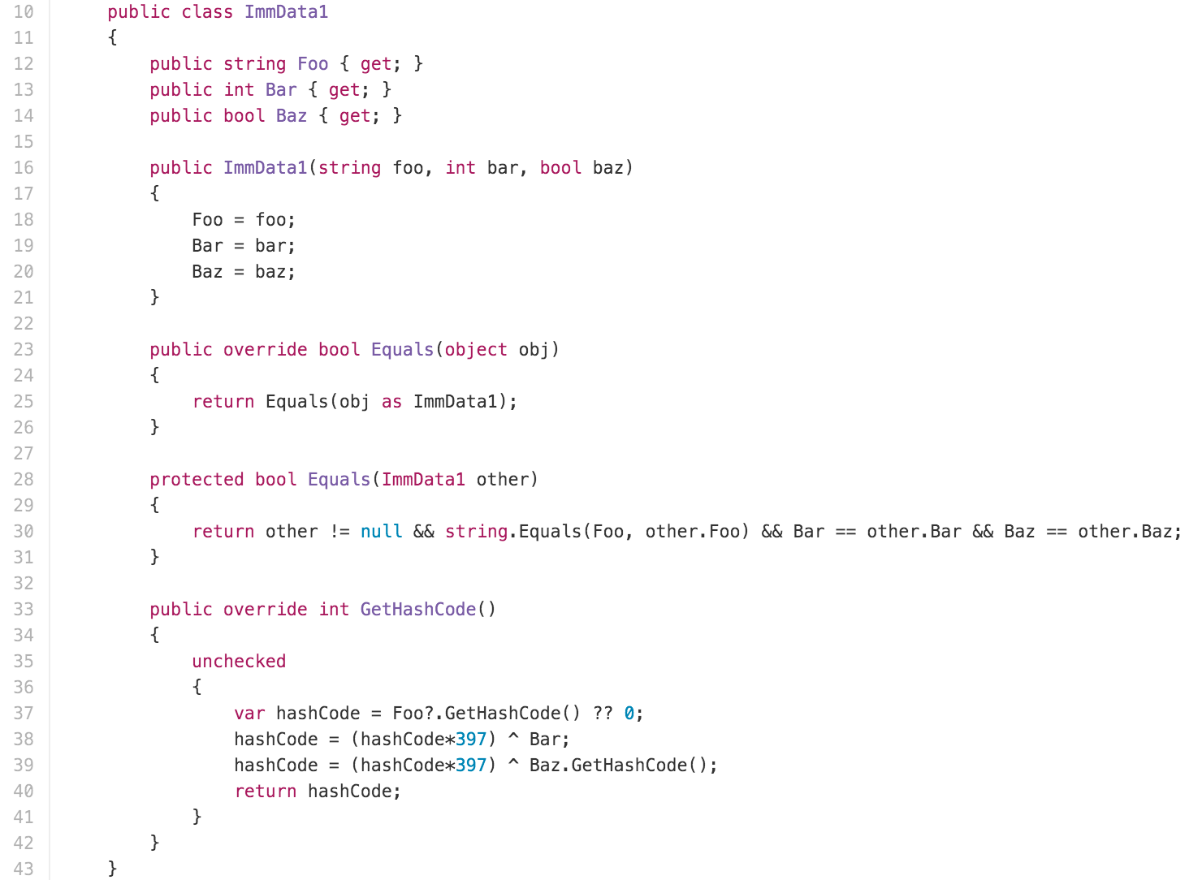
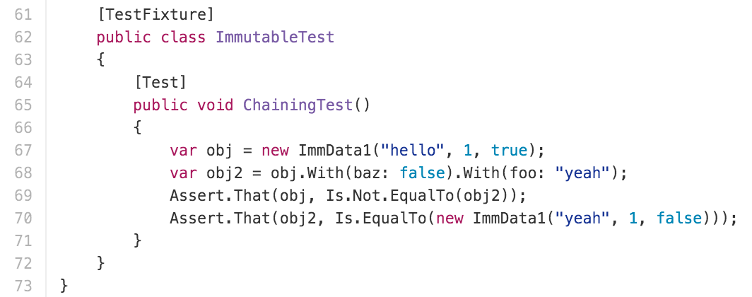
IMMUTABILITY

Slide 24
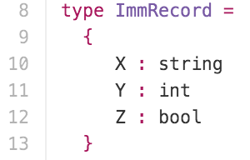
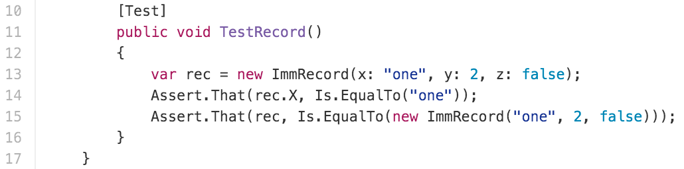
IMMUTABILITY

Slide 25
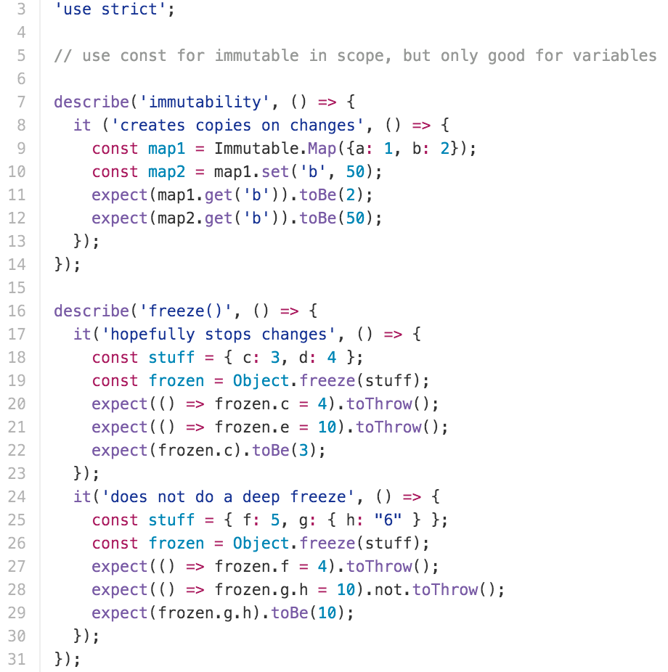
IMMUTABILITY

Slide 26
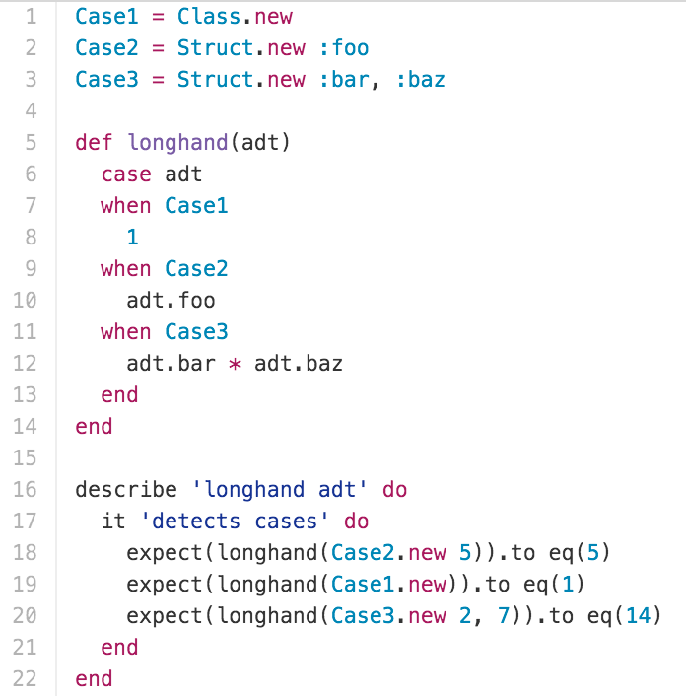
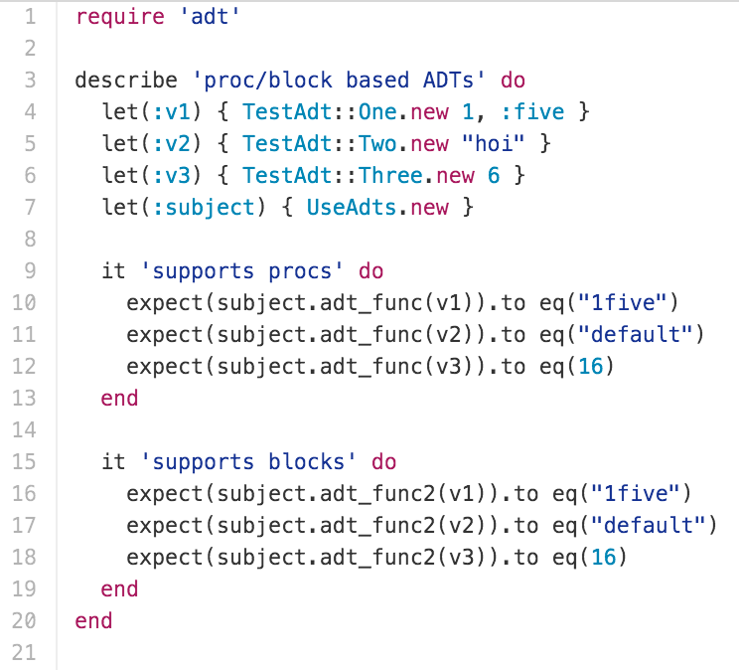
Algebraic Data types

Slide 27
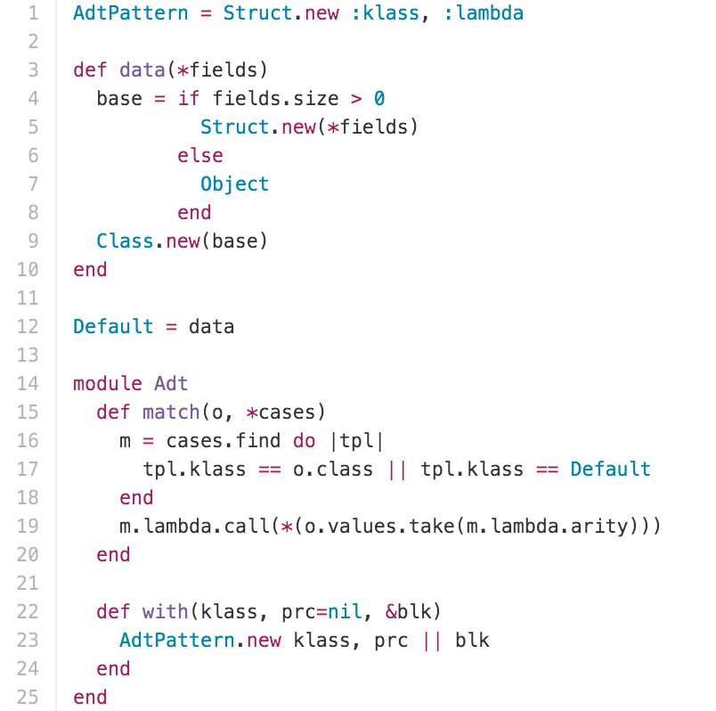
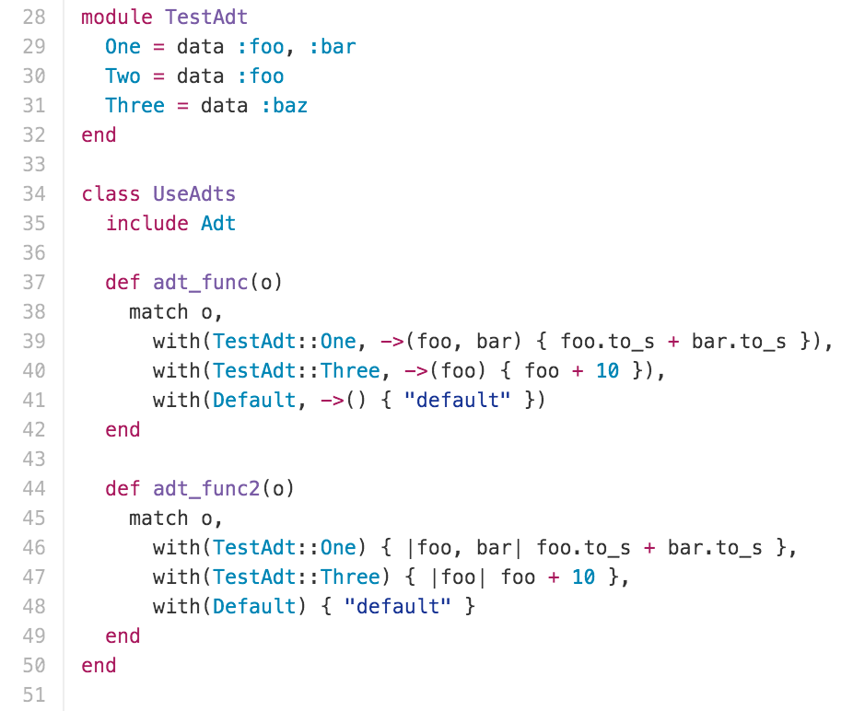
Algebraic Data types

Slide 28
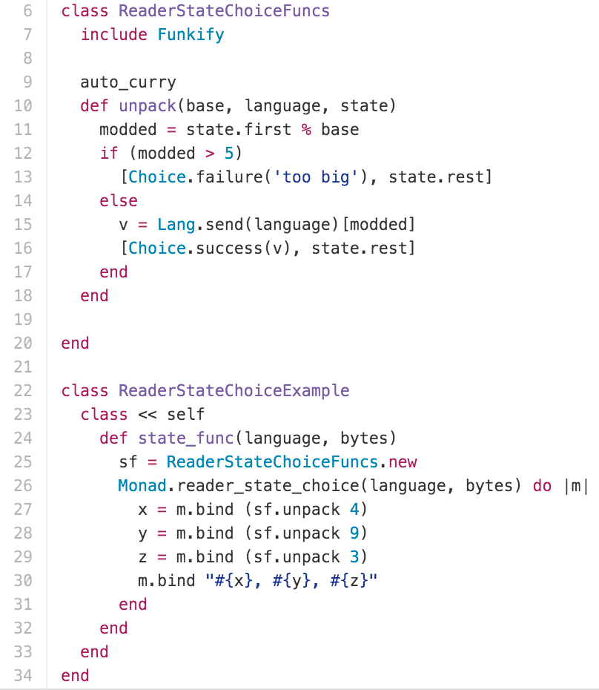
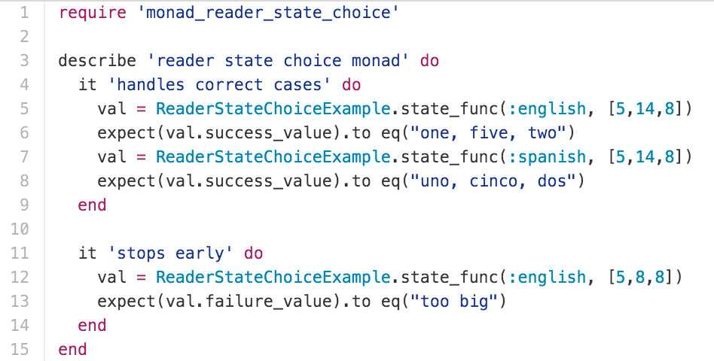
MONADS

Slide 29
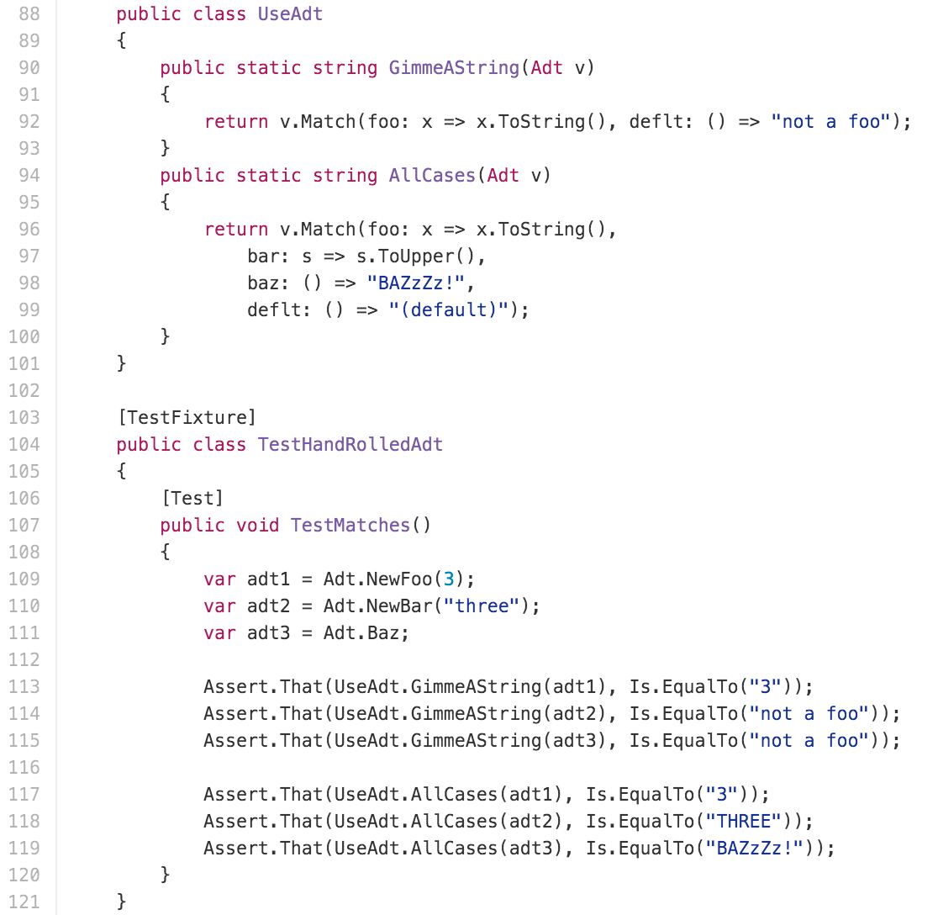
Algebraic Data Types

Slide 30
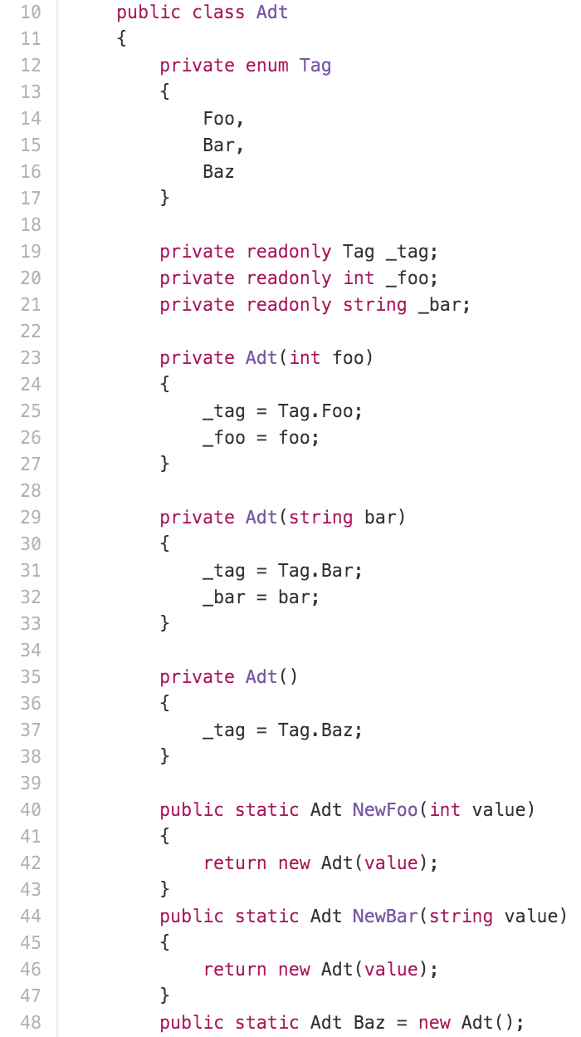
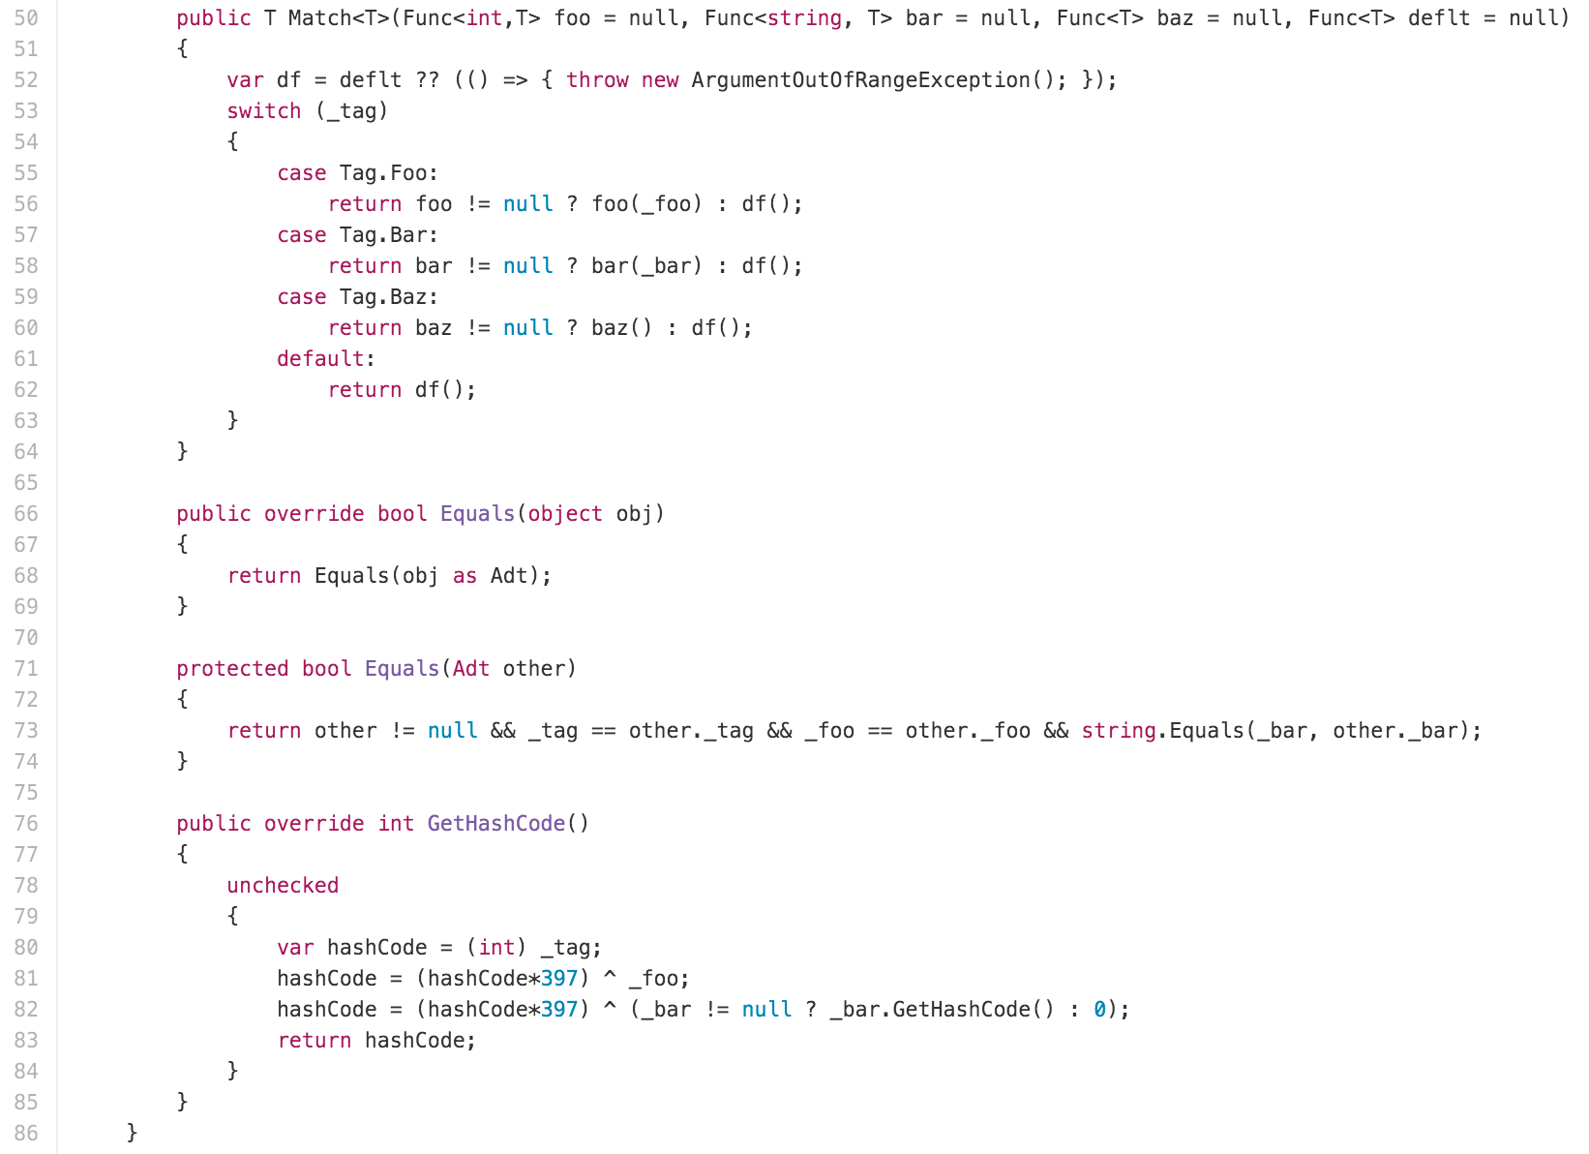
Algebraic Data Types

Slide 31
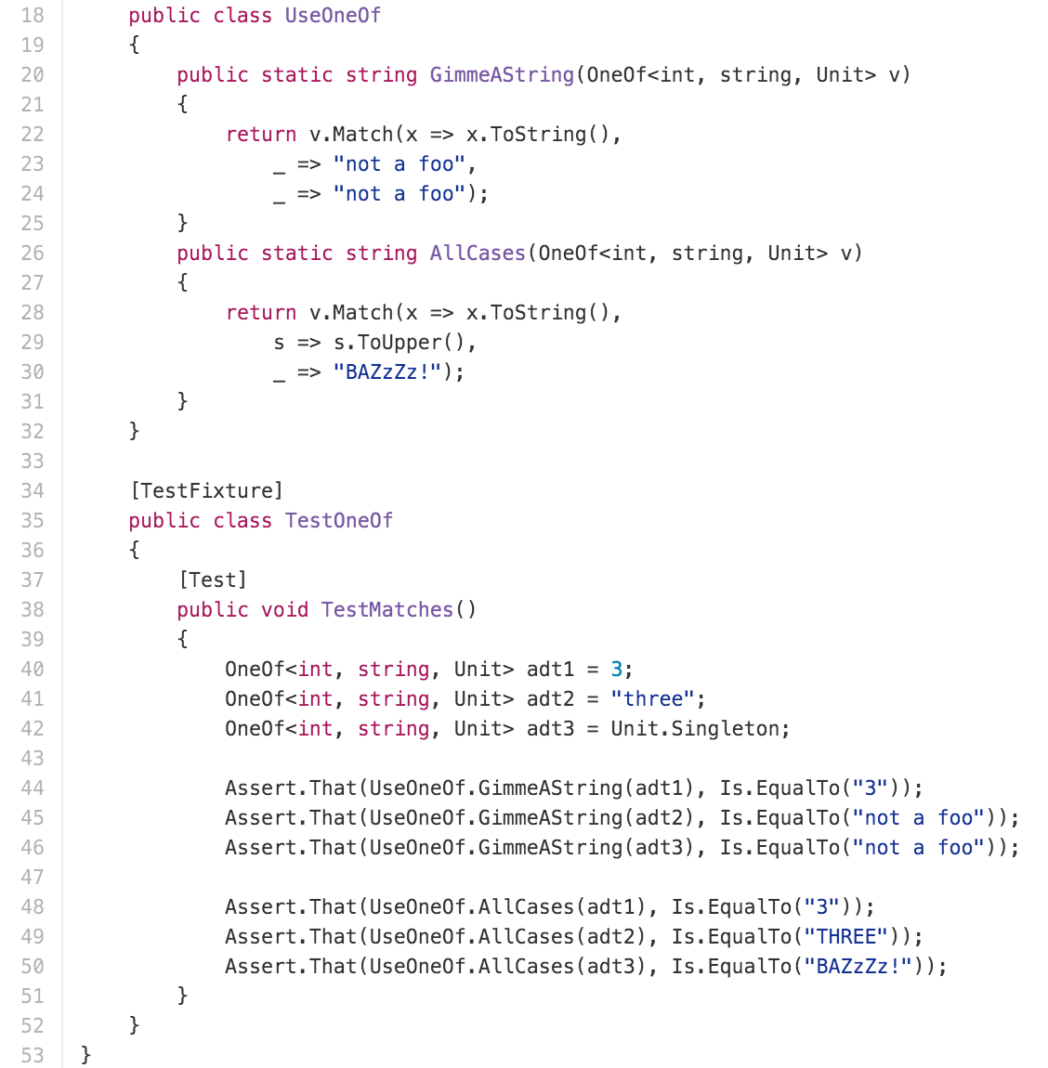
Algebraic Data Types

Slide 32
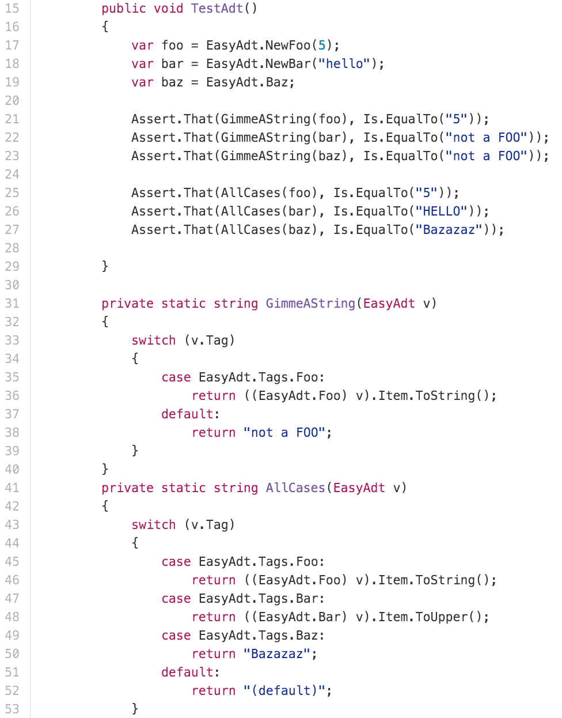
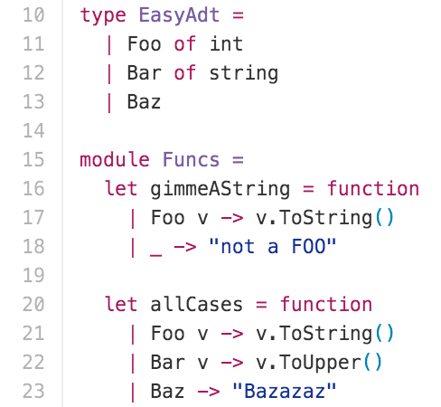
Algebraic Data Types

Slide 33
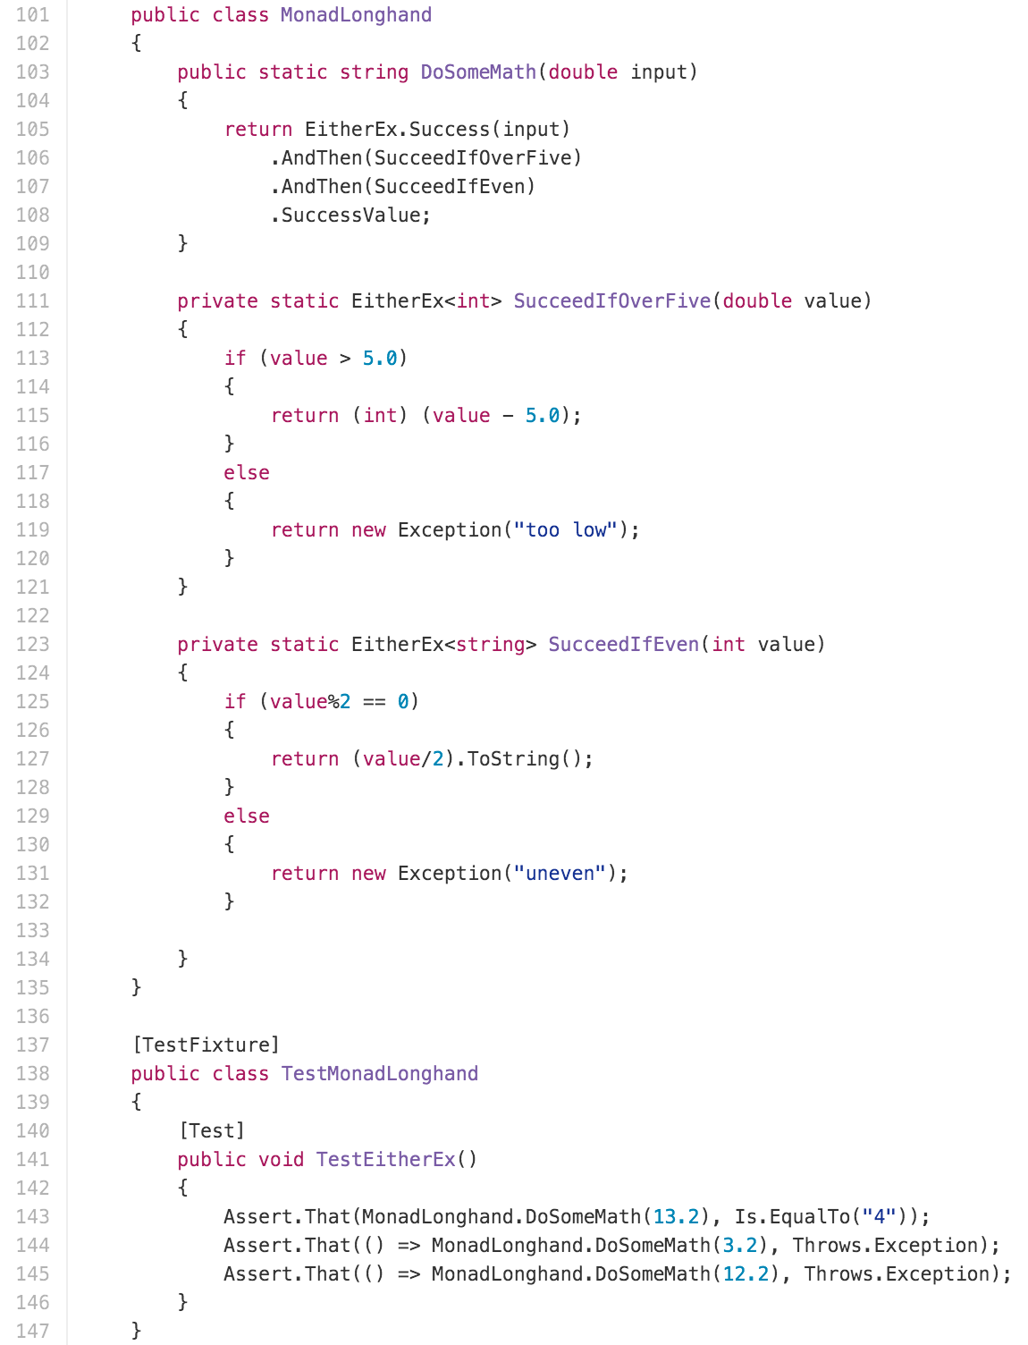
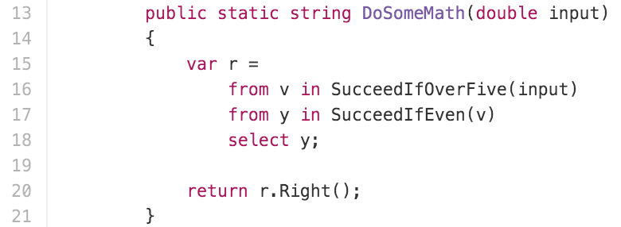
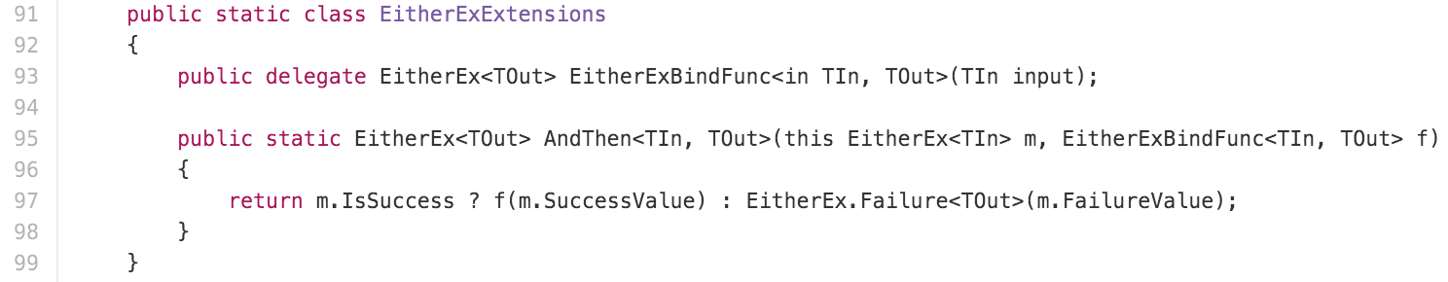
MONADS

Slide 34
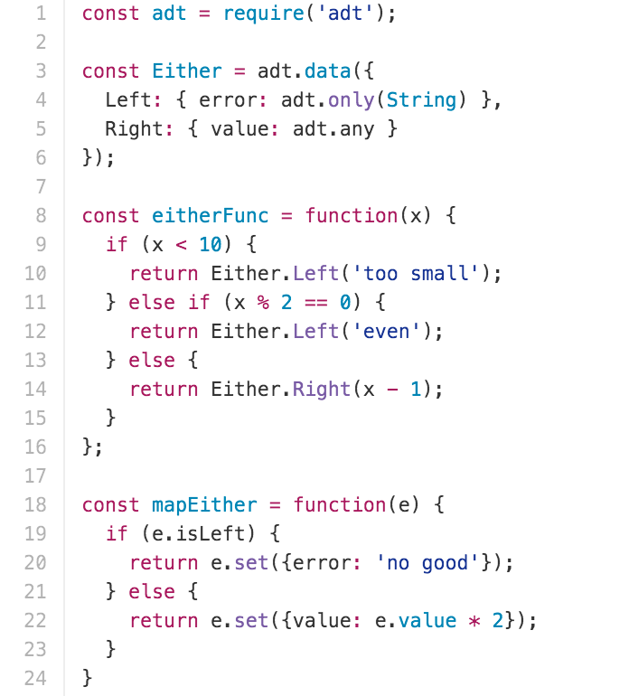
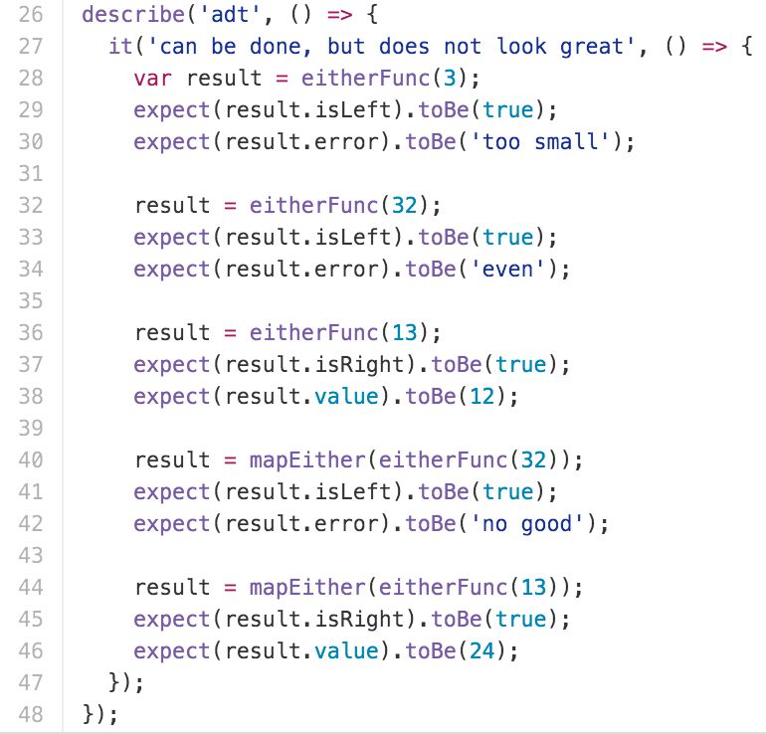
Algebraic Data Types

Slide 35
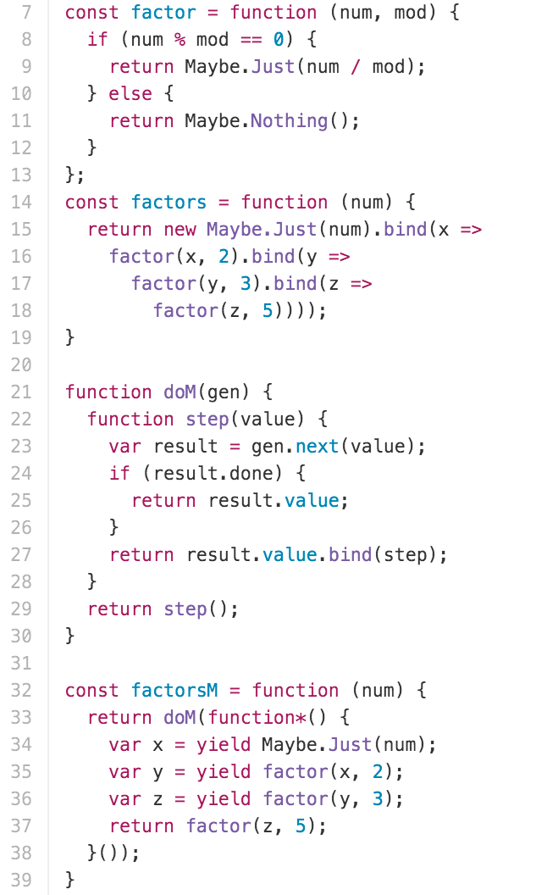
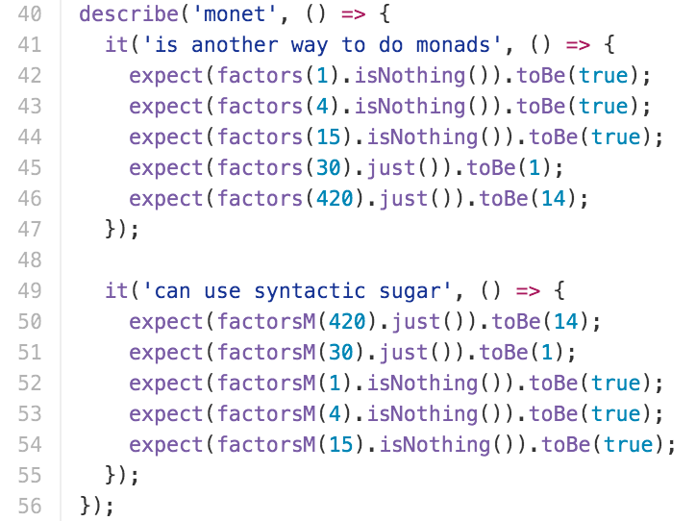
MONADS

Slide 36
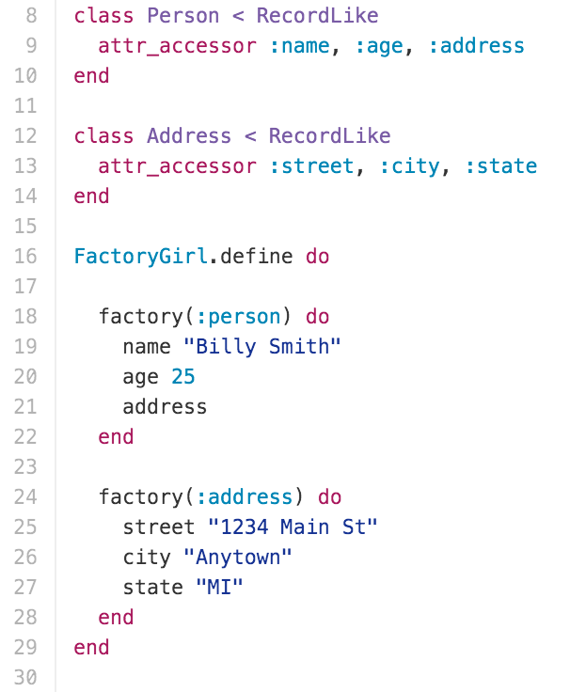
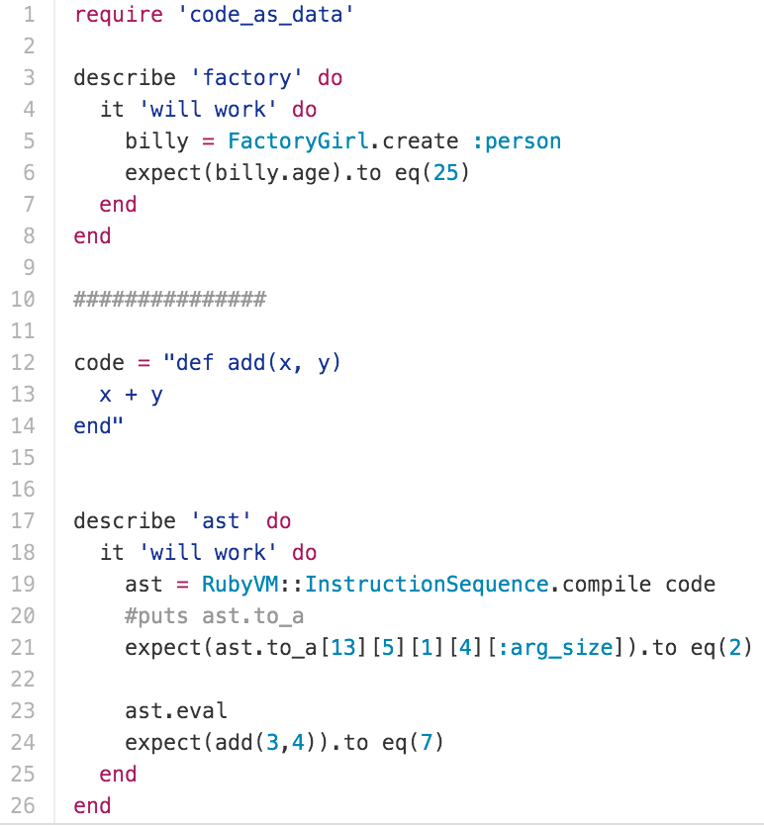
METAPROGRAMMING

Slide 37
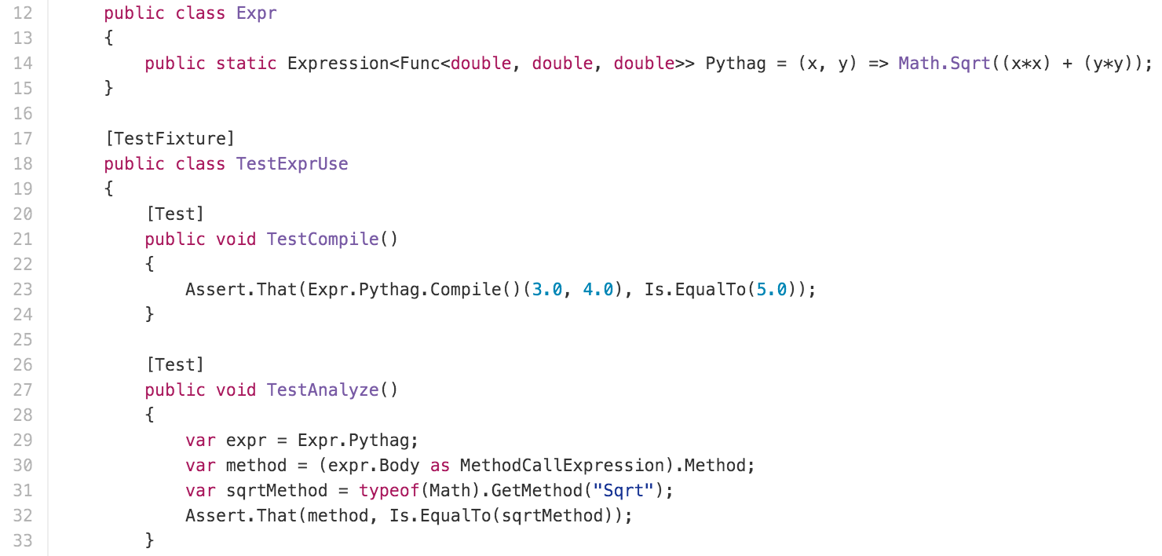
METAPROGRAMMING

Slide 38
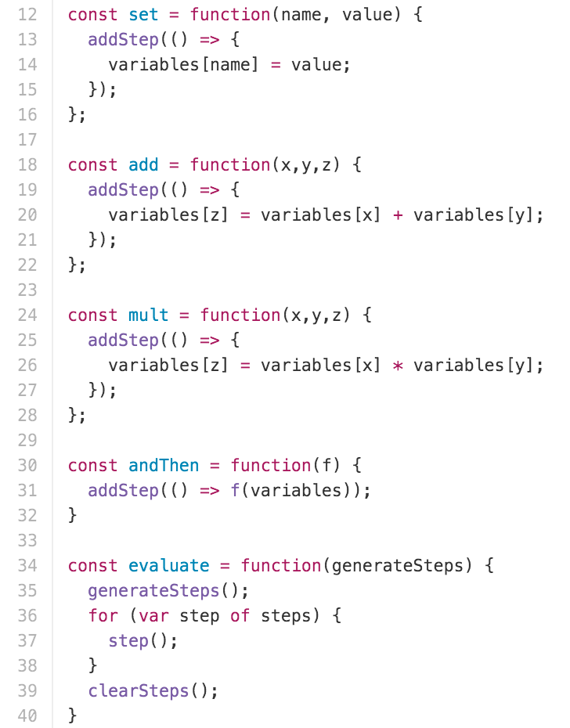
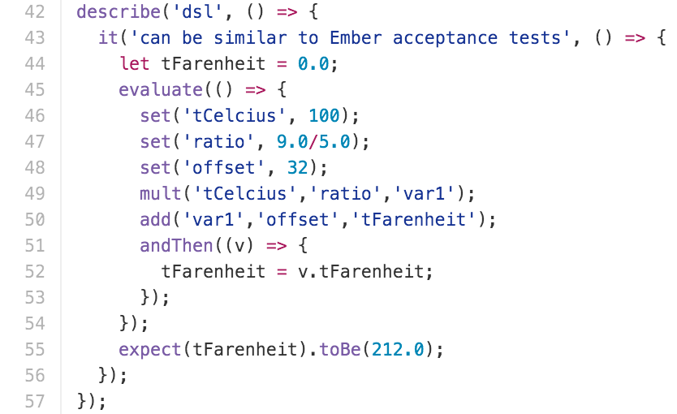
METAPROGRAMMING

Slide 39
CONCLUSION

Slide 40

GOOD LUCK AND GOOD NIGHT
Will Pleasant-RYan
will.ryan@atomicobject.com
@KreliAnodos
https://github.com/willryan/functional-oo

